Slide 1


Trending YouTube Videos in the USA presented by: Group four (Four consulting Firm)
Group members:
Deborah Olubolade
Mary Makanjuola
Flourish Erhijakpor

Slide 2
Executive summary
Four Consulting firm is a Nigeria based company working in the field of digital marketing and market analysis. The company is currently engaged by a USA based media company to provide a trend analysis on the top ten trending YouTube videos from the USA. With the aim to develop strategies towards marketing their upcoming projects.
The expected results was to show the contributory factors for trending videos on YouTube also provide strategies on how to promote the company’s upcoming projects.
It is expected that these findings will benefit the company to improve its output visage and increase market size as well as profit both in the USA and Globally.
The client company has been experiencing a downturn in its YouTube subscribers' targets and views lately despite maximum efforts channeled towards its media productions. Hence a need for an exploratory analysis of trending videos to guide its re-strategy of its YouTube products.

Slide 3

Data description
The data head column shows the video ID, title, trending date, tags, views, likes, dislikes, links and descriptions. The total set review was 40949 videos within the month of November. Below is a descriptive table that gives the overview of the data
 | views | likes | dislikes | comment count
mean | 2360784.6 | 74266.7 | 3711.4 | 8446.8
std | 7394113.8 | 228885.3 | 29029.7 | 37430.5
min | 549.0 | 0.0 | 0.0 | 0.0
max | 225211923. | 5613827. | 1674420 | 1361580
Count (n) = | 40949 | 40949 | 40949 | 40949
Notes:
The dataset explore was derived from the Kaggle (https://www.kaggle.com/), a public dataset that contained the raw files of YouTube uploaded videos. The dataset is not a machine learning data hence we are only extracting to see how the data can benefit the business.
The files have 40949 records showing: headings around video_id, trending_date , title, channel_title, category_id, publish_time, tags, views, likes, dislikes, comment_count, thumbnail_link, comments­_disabled,ratings_disabled, video_error,_or_removed description

Slide 4
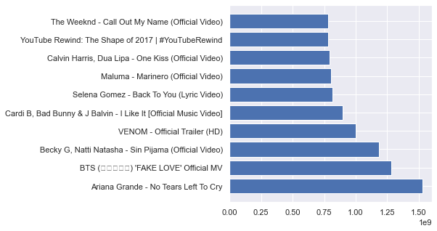
Data visualization
Fig 2. top ten most viewed videos
Fig 1. top ten most liked videos

Slide 5
Conclusion
The most trending videos from the analysis suggested that some level of influencers engagement was done, also the hashtags used for such videos boosted the number of views.
Upon reviewing the most viewed video from the top 10 list; one of the contributory factors was the size of the video uploaded and its quality level as well.
From the result, the number of views corresponded to the number of likes hence the company should consider taking the following steps to achieve its aim:
Be conscious of the file sizes to be uploaded
Be sure of the video quality and use a catchy thumbnail
Use most trending tags
Engage top ranking influencers to boost trend and a special tag that may be created for the project
Consider linking the YouTube page with the company other social media platforms.
Create a campaign schedule around the products

